Slide 1
Predicting Effective Arguments in an Essay
By: Srihari Inukurthi and Jason Lee

Slide 2

Project Description
Aim is to create a model to predict the effectiveness in an argumentative essay
Essays will be evaluated and assessed into three categories:
Effective
Adequate
Ineffective
Motivation is to create an automated feedback for students to instantly get reports of their writing
Notes:
For our project, we are developing a predictive model focused on rating the effectiveness of argumentative essays. Our model has been trained on a dataset comprising argumentative writings across 6th to 12th grades in the United States. Within this dataset, essays are evaluated and categorized into three distinct groups: effective, adequate, and ineffective.
To elaborate on our approach, our model assesses each vital element within an argumentative essay, including but not limited to the proposal, evidence, claim, and more. This comprehensive evaluation allows the model to categorize the entire essay into one of the three aforementioned categories.
Our motivation is to support students lacking adequate resources that hinder their writing skills, ensuring they keep up with their peers. This model offers instant feedback, promoting consistent practice and skill enhancement for individual learning

Slide 3
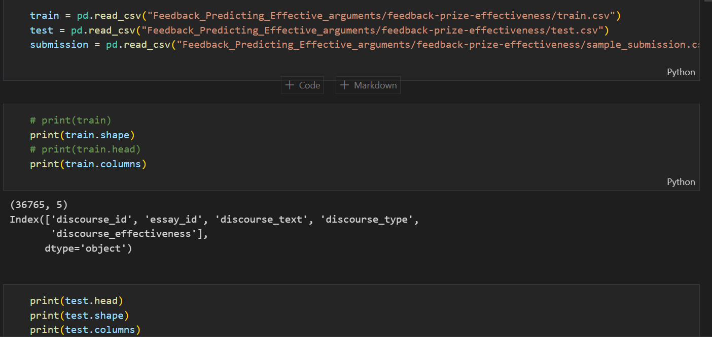
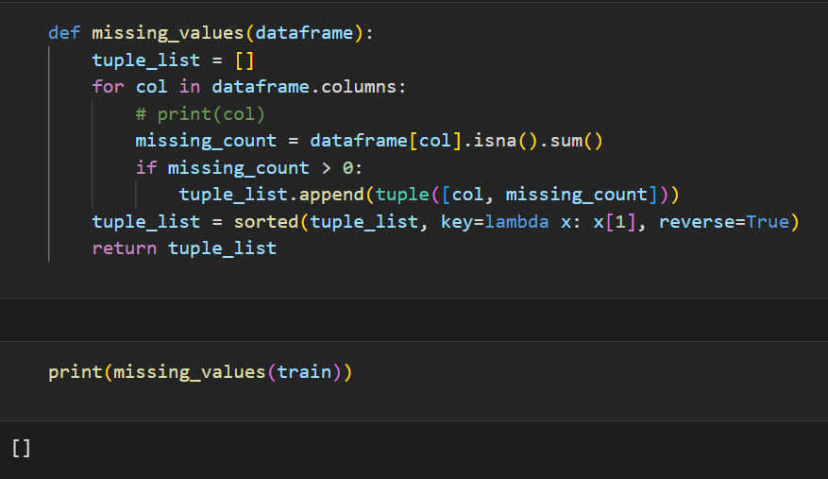
Dataset Reading and Exploratory Data Analysis
Notes:
We utilize the pandas library’s ‘read_csv’ method to read the dataset, understanding its dimensions and performing an analysis. The dataset includes columns labeled ‘discourse_id’, ‘essay_id’, ‘discourse_text’, ‘discourse_type’, and ‘discourse_effectiveness’. We also verify the absence of any missing values in any of the columns and perform imputation if necessary. In this case, there are no missing values

Slide 4
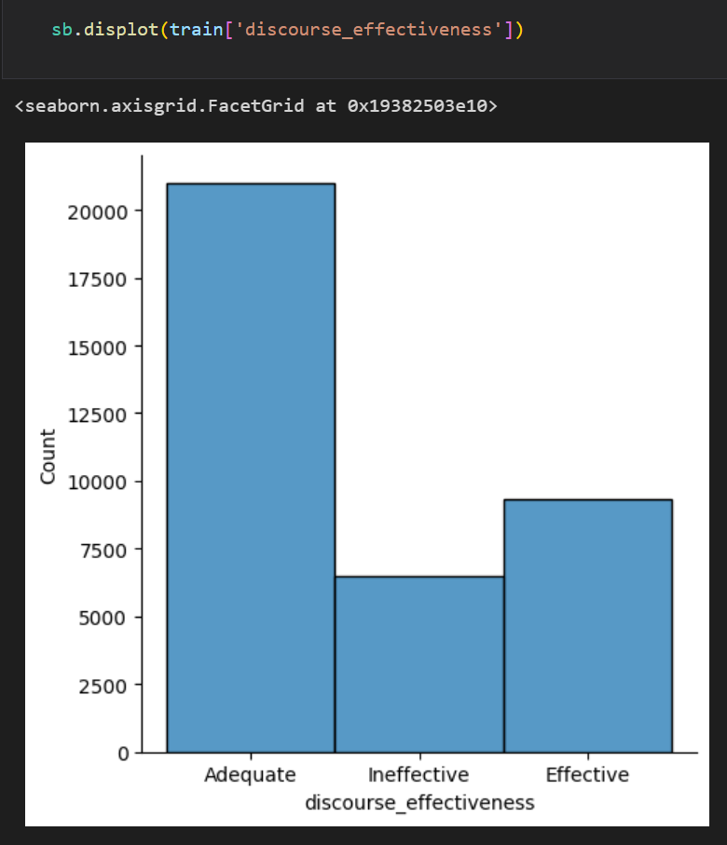
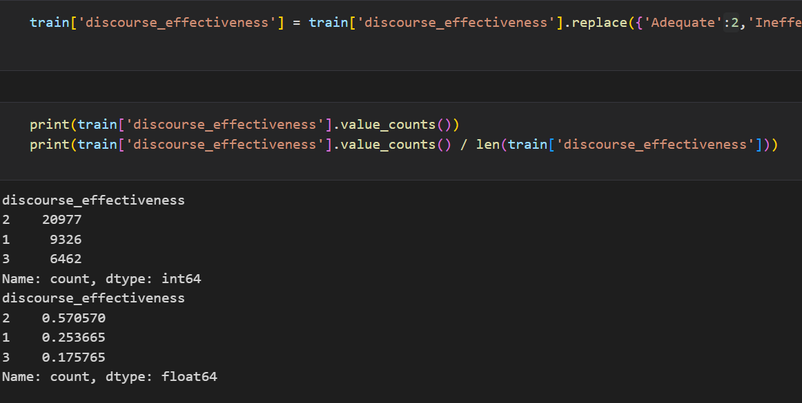
Dataset Reading and Exploratory Data Analysis
Notes:
In this context, we aim to visualize the distribution of data for which are graded as ‘Adequate’, ‘Ineffective’, and ‘Effective’ using ‘displot’, focusing on the sample count within each target class for training, both in univariate and bivariate perspectives. We’ve determined the count and percentage of essays that are categorized into the three respective groups, relative to the total number of samples.

Slide 5
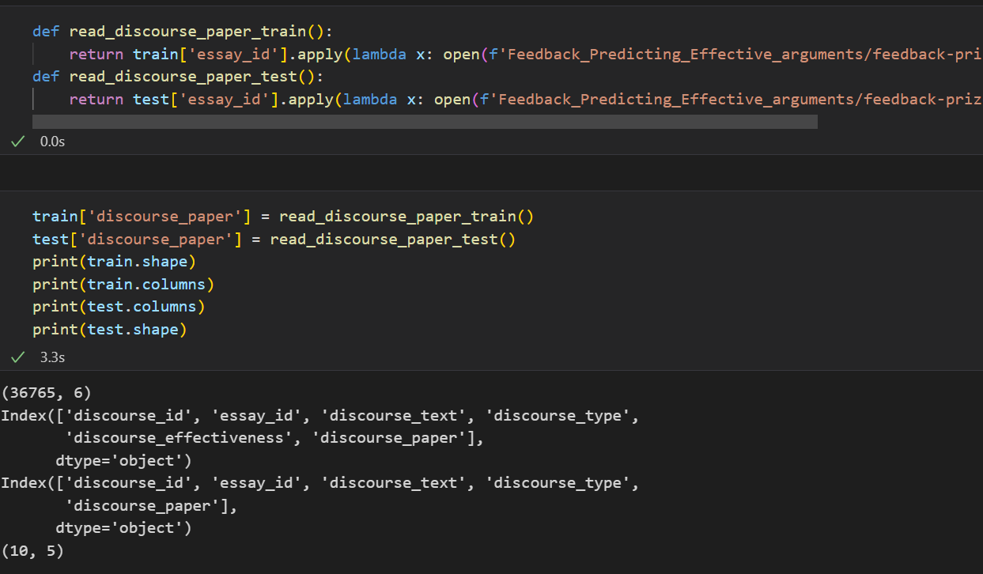
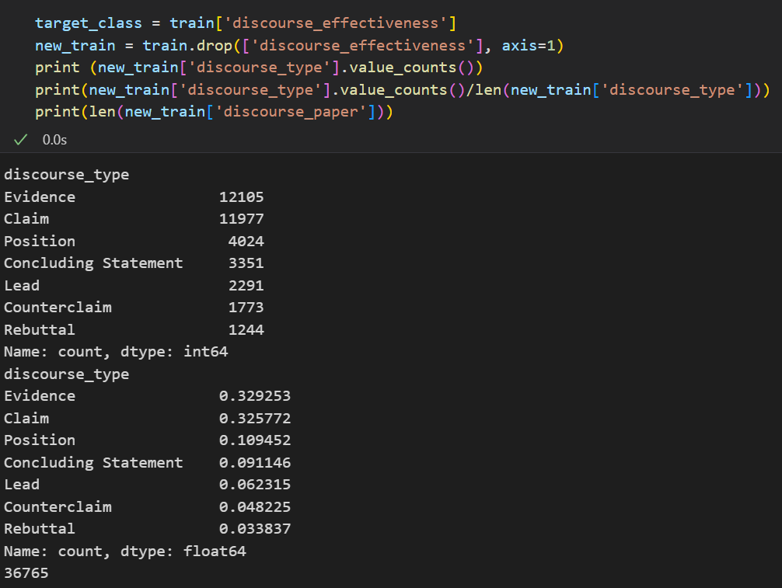
Data cleaning and Pre processing
Notes:
In the process of data cleaning and preprocessing, we augmented our dataset by including a new column containing the complete essay text for each sample, moving beyond just the individual elements with effective ratings. We excluded the target variable, 'discourse_effectiveness,' saving it into a separate variable. Furthermore, we conducted an analysis on discourse type features, specifically the elements of argumentative content, calculating their count and percentage

Slide 6
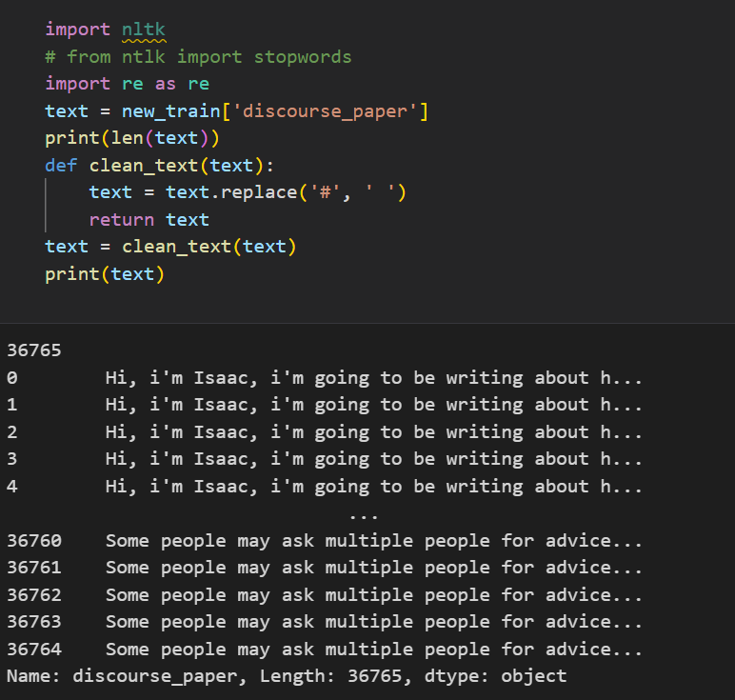
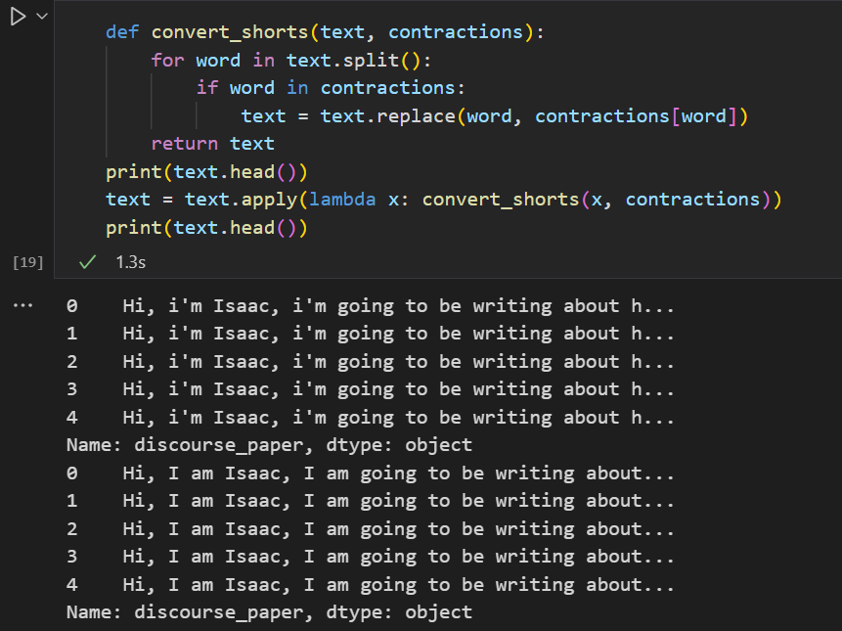
Data cleaning and Pre processing
Notes:
We standardized our text data files by replacing any occurrences of "#" with blank spaces. Additionally, we performed character cleanup to remove unnecessary characters and expanded contractions to their formal definitions throughout the entire essay. For instance, "i'm" was replaced with "I am."

Slide 7
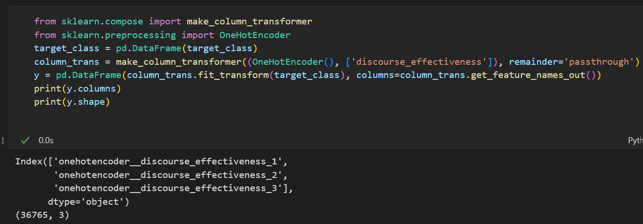
Data cleaning and Pre processing
Notes:
Lastly, we employed one-hot encoding to transform the target variable, 'discourse_effectiveness,' which includes categories like adequate, ineffective, and effective, into three separate columns. This was necessary as the output comprises multiple distinct variables rather than a single on

Slide 8
Building Model
Before building a model, we need to convert all the text sentences into a vectors.
This is considered as a partial classification and partial regression problem.
We plan on using 2 models one on top of the other.
We use a classification algorithm and on top of that we use a regression algorithm that can produce multiple predictions of a target.

Slide 9
Future plans
After creating the model, we plan to evaluate the model based on the given test samples.
If the model performance is not good enough, we plan to improve the model’s performance by fine tuning the model.
If the fine tuning is not very much helpful, we plan on using a different model as a backup that is helpful in predicting the effective arguments in an essay.

